Slide 1
Napoleon Bonaparte´s buildings
Alicja kotlarczyk, jimena díaz, panagiotis psarras

Slide 2
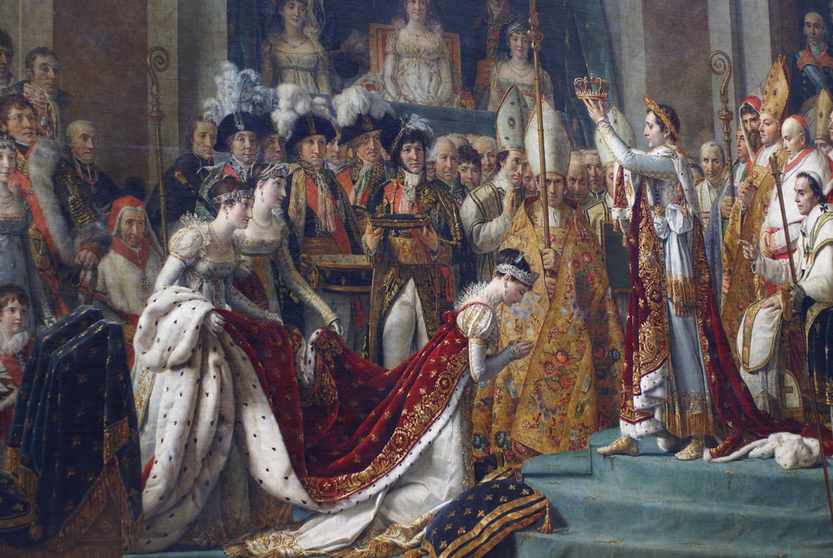
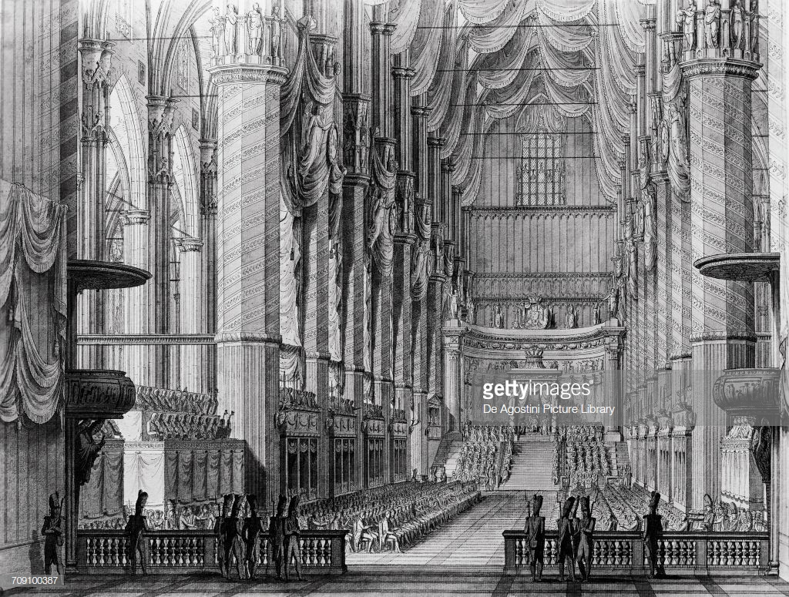
Notre – Dame of Paris
Notre-Dame was the scene of some French royal services, notably solemn entries, Te Deum's of thanksgiving, funeral and wedding services, but it was not until the First Empire and the great events held in the cathedral during that period that the building rightfully became to be known as the 'the parish of the history of France
Npoleon had a splashy ceremony in Notre Dame Cathedral, wore a gold and fur-trimmed robe, and crowned himself emperor on Dec. 2, 1804. Then he crowned his wife Josephine as empress.
It was subsequently no coincidence that Napoleon should choose Notre-Dame for his coronation ceremony. And a great deal of preparatory work was undertaken. Houses were demolished to clear the surroundings of the cathedral, and Napoleon ordered that the streets along which the cortege was to pass, namely rue de Rivoli, the Place du Carrousel and the Quai Bonaparte, should be entirely paved. Percier and Fontaine designed a neo-Gothic style portico to be placed on the forecourt in front of the cathedral; this was made of wood, card and stucco and it led via a covered gallery decorated with Gobelins tapestries into the interior of the building and so on.

Slide 3
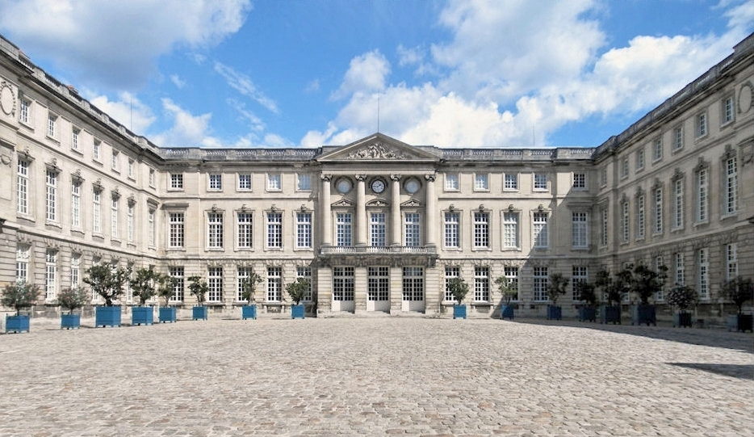
Compiegne
Built by Louis XV and Louis XVI and remodeled both by Napoleon I and Napoleon III, the Palais de Compiegne was a center for court life and the exercise of power. The originality and beauty of this, the largest neo-classical palace in France, and the quality of its interior decor and furnishings make for a unique ensemble. Alongside Versailles and Fontainebleau, this historic site is one of the three largest royal and imperial residences in France.
On 12 April 1807, Napoleon gave the order to completely refurbish Compiègne. Straight away, major work on the palace’s interior was launched, led by the architect Louis-Martin Berthaut, who had recently carried out work for Joséphine at the Malmaison. The works took place between 1808 and 1810.

Slide 4
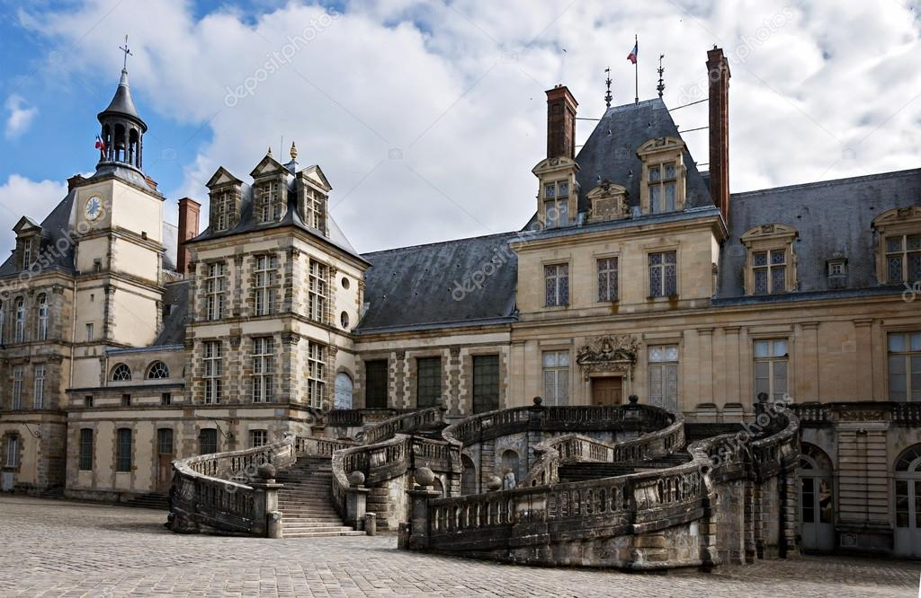
Fontaonebleu
The palace in which every king of France since the Middle-Ages had lived was spared during the Revolution, but the furniture was either destroyed or sold. Napoleon had the palace both restored and refurbished, thus making it once again a residence fit for royal guests. Almost 600 rooms were transformed to accommodate the court, and the furniture needed for them was either taken out of storage or orders were placed with cabinet-makers such as (Jacob-Desmalter…) and with tapestry-makers such as Baudoin, Legendre, and Decors.
Napoleon's suite was entirely remodelled again in 1804.
Pope Pius VII came to Fontainebleau to officiate at Napoleon's coronation.
A museum entirely devoted to Napoleon Bonaparte was thus created in Fontainebleau, its aim being to present a view of the Emperor and his family.

Slide 5
THANK YOU FOR YOUR ATTENTION

