Slide 1
Napoleon Bonaparte battles
Andrea Devečková, Jessica Kania, Adrián Atienza

Slide 2
Battle of Eylau
Battle of Eylau, (Feb. 7–8, 1807), an engagement in the Napoleonic Wars
After a succession of victories to 1806, Napoleon was fought to a standstill, the first major deadlock he ever suffered, in a bitter engagement with the Russians at Eylau (modern Bagrationovsk, Russia), 23 miles (37 km) south of Königsberg (Kaliningrad).
The 76,000 Russians and Prussians under Leonty Leontyevich Bennigsen confronted 75,000 men under Napoleon
During the night, Bennigsen withdrew from the battlefield; the French were in no state to pursue their opponents.
Losses: Allied Russian-Prussian, 15,000 casualties of 76,000; French, at least 15,000 casualties of 75,000.

Slide 3
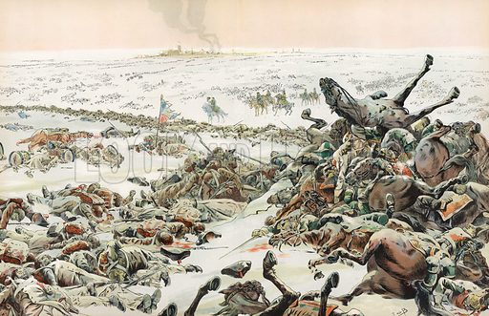
Battle of Eylau

Slide 4
Battle of Friedland
Battle of Friedland, (June 14, 1807), victory for Napoleon that compensated for a setback the preceding February at the Battle of Eylau and that forced Russia’s emperor Alexander I to accept French terms at the Treaty of Tilsit, which left Napoleon the undisputed master of western and central Europe.
It was fought at Friedland (modern Pravdinsk, Russia), 27 miles (43 km) southeast of Königsberg (now Kaliningrad, Russia) in East Prussia.
About 80,000 troops of Napoleon’s Grand Army (including Polish, Dutch, Italian, and German units) confronted about 58,000 Russians under the command of General Leonty Leontyevich Bennigsen.
French, about 9,000 casualties of some 80,000; Russian, some 20,000 casualties of about 60,000.

Slide 5
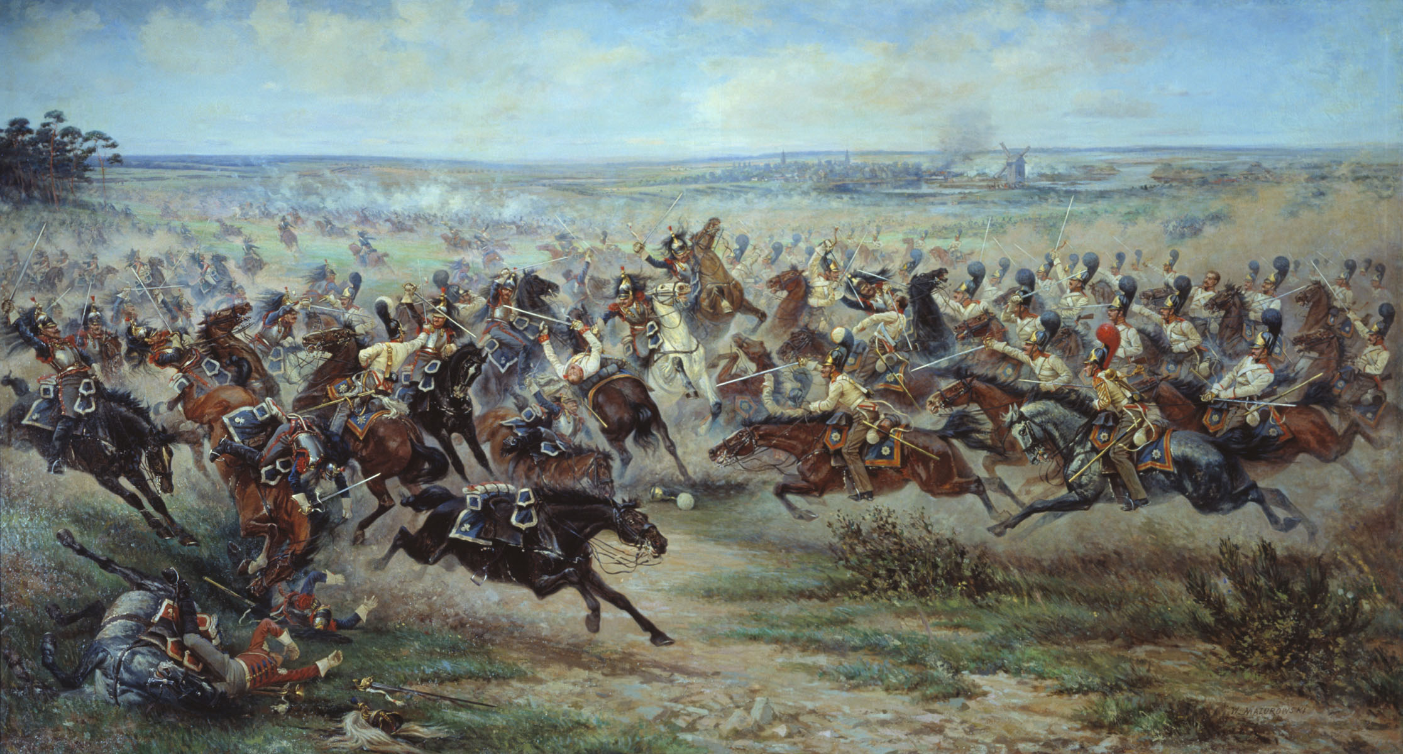
Battle of Friedland

Slide 6
Battle of Borodino
Battle of Borodino, (Sept. 7 [Aug. 26, Old Style], 1812), bloody battle of the Napoleonic Wars, fought during Napoleon’s invasion of Russia, about 70 miles (110 km) west of Moscow, near the river Moskva.
It was fought between Napoleon’s 130,000 troops, with more than 500 guns, and 120,000 Russians with more than 600 guns.
Napoleon’s success allowed him to occupy Moscow.
The French lost about 30,000 men. Although the Russian army was badly mauled, it survived to fight again and, in the end, drove Napoleon out of Russia

Slide 7
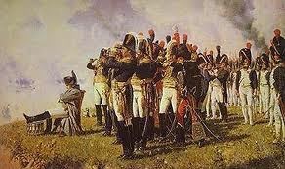
Battle of Borodino

Slide 8
THANK YOU FOR YOUR ATTENTION

