Slide 1
Napoleon Bonaparte battles
Zuzanna harupa, jaime moreno, marios tzimotoudis

Slide 2
Waterloo
The Battle of Waterloo was fought on Sunday, 18 June 1815, near Waterloo in present-day Belgium, then part of the United Kingdom of the Netherlands.
French army was under the command of Emperor Napoleon Bonaparte.
He was defeated by a Seventh Coalition: a British-led Allied army under the command of the Duke of Wellington and a Prussian army under the command of Gebhard Leberecht von Blücher, Prince of Wahlstatt.
The battle marked the end of the Napoleonic Wars.

Slide 3
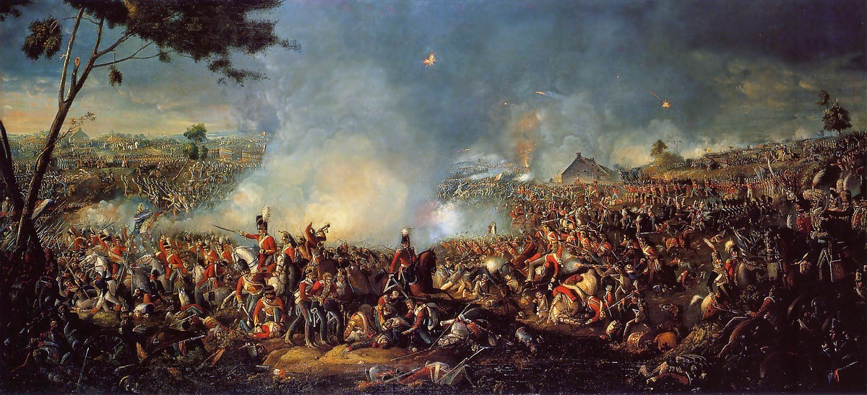
Waterloo

Slide 4
Saint Helena
In 1815, the British government selected Saint Helena as the place of detention for Napoleon Bonaparte.
He was taken to the island in October 1815.
Napoleon stayed at the Briars pavilion on the grounds of the Balcombe family's home until his permanent residence at Longwood House was completed in December 1815.
Napoleon died there on 5 May 1821

Slide 5
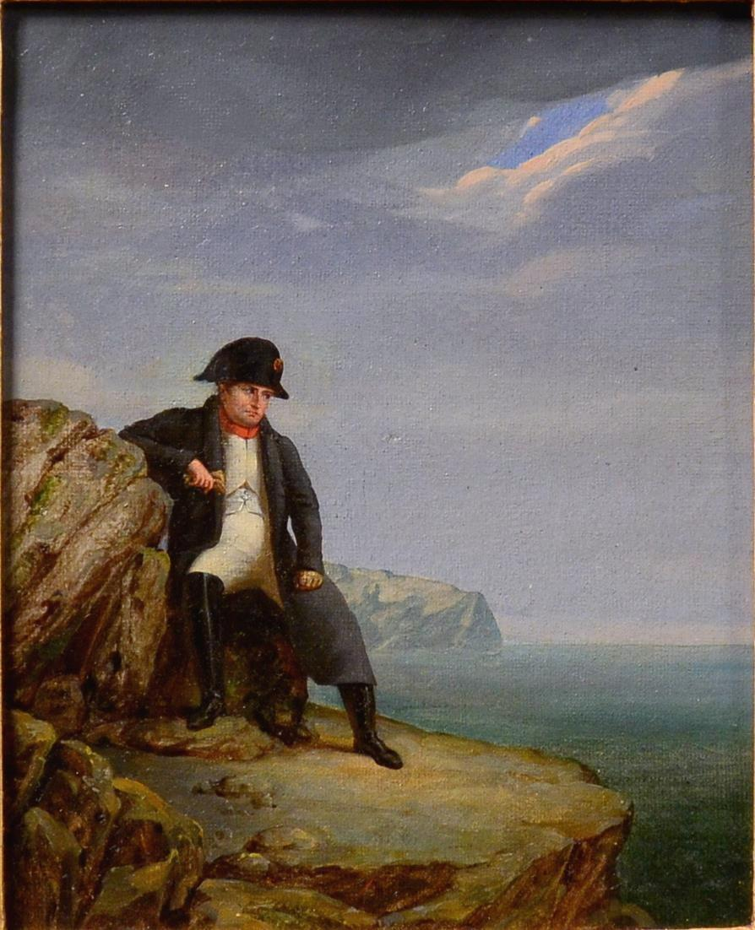
Napoleon on Saint Helena

Slide 6
THANK YOU FOR YOUR ATTENTION

